Slide 1
CS6140 - Group #17 SVM And TIME-Series modeling on Stock market Trends

Slide 2
AGENDA
SVM Model
Time-series Baseline
SVR Model

Slide 3
SVM Modeling

Slide 4
SVM Model Overview
Classifying a stock as a hold or not-hold on a given day
Input feature for open to close price change.
Input feature for high to low price change.
Use these for each day, predict the next day.
Next day close > current day close is a ‘Hold’.
Compare returns each day to only returns on predicted ‘Hold’ days.
Split 80% days before cutoff to train, test on 20% days after cutoff.
Model each stock individually – cumulative returns for market

Slide 5
SVM and time-series Articles
Other resources
How-To: Cross Validation with Time Series Data | by Haden Pelletier | Towards Data
Predicting Stock Price Direction using Support Vector Machines – GeeksforGeeks
S&P 500 || Time Series Forecasting with Prophet (kaggle.com)

Slide 6
Additional Features Attempted
Change in Returns over the past 7 days
Change in Returns over the past 14 days
Change in Volume of the Stock, past day
No significant findings for these features

Slide 7
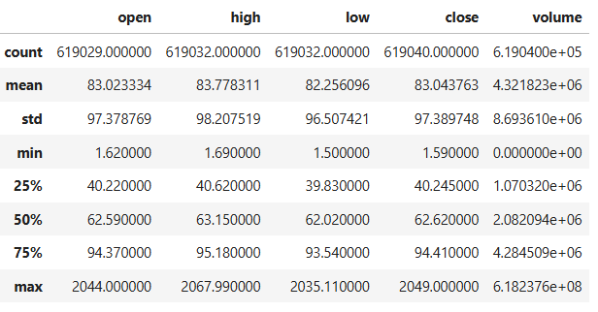
S&P 500 data
Min date: 2013-02-08 Max date: 2018-02-07
From February 8th, 2013, to February 7th, 2018.
Data source: S&P 500 || Time Series Forecasting with Prophet (kaggle.com)

Slide 8
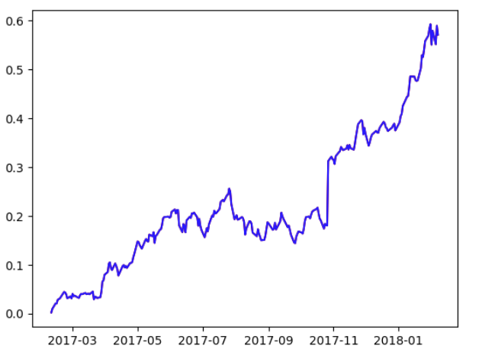
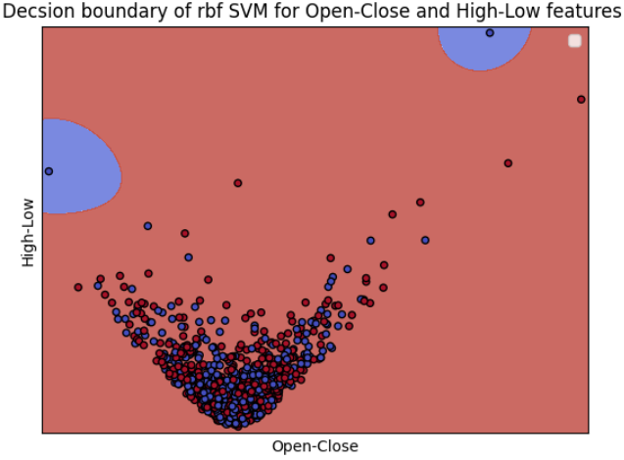
SVM Example - AMZN
The model predicts to almost always hold AMZN
Red – Hold, Blue – Don’t Hold
- Decimal (Y-Axis * 100 for percentage)
- Cumulative returns

Slide 9
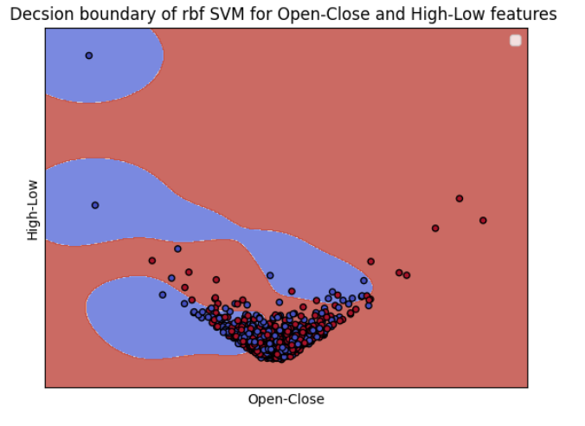
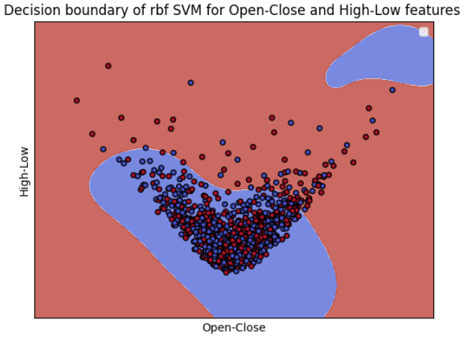
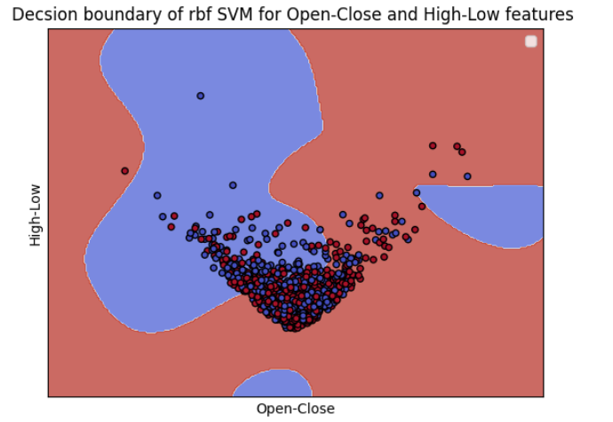
SVM Example – Visa, MSFT, CAT
Visa
Red – Hold, Blue – Don’t Hold
Good at classifying Don’t Hold Outliers
CAT
MSFT

Slide 10
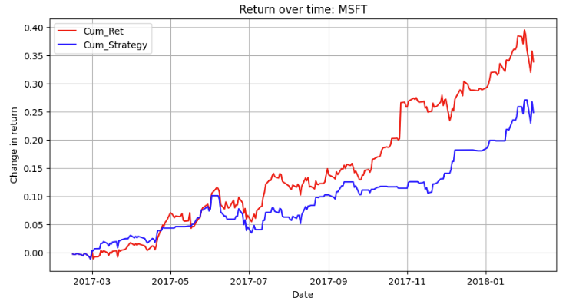
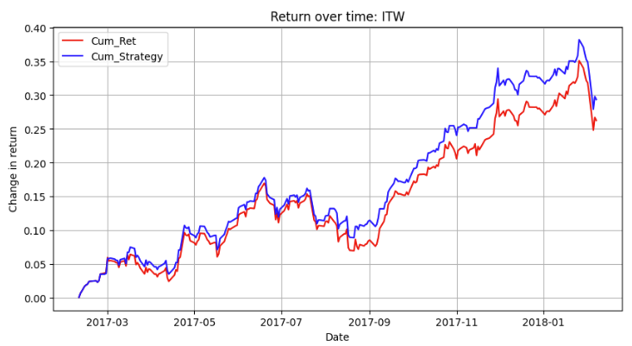
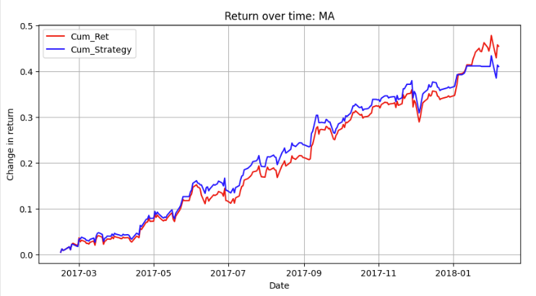
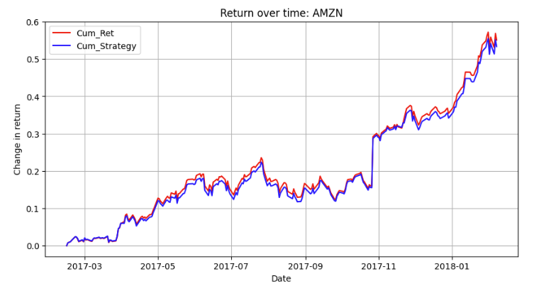

Slide 11
What is the issue with this Approach?
~50% test accuracy depending on the stock
Training and test data is split on date.
Predictions are generally less helpful the further we move from the training date.
Can we predict for only the short-run and see an improvement?

Slide 12
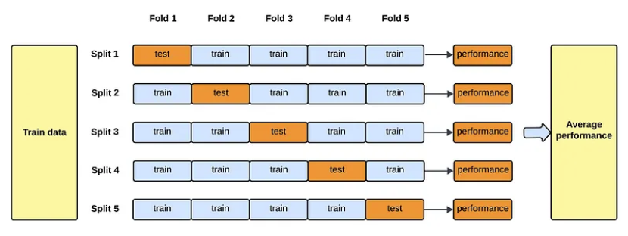
SVM and time-series Analysis
Use time-series kfold split:
Use sklearn TimeSeriesSplit – Train (0 – N days), Test (N+1, N+30 days)
Compare the cumulative returns for the next day, 3 days, 5 days, 10 days, 15 days
Also helps confirm we are not overfitting

Slide 13
AvG. Performance Of SVM model
Average 52% accuracy.
Average 56% F1-score.
Average 53% precision.
Average 67% recall.

Slide 14
Our Model Shows Signs of Better Returns than the Market, One day out
TimeSeriesSplit cross validation, sum the cumulative returns one day out
Compare cumulative market returns one-day out to our returns one-day out
Some example show improvements over the market, most examples do not beat the market in the long-run
Not able to conclusively show performance improvements over the market, would need to experiment with other features for predictions
The model seems to perform particularly well at AVOIDING downturns, it is not good at predicting spikes.

Slide 15
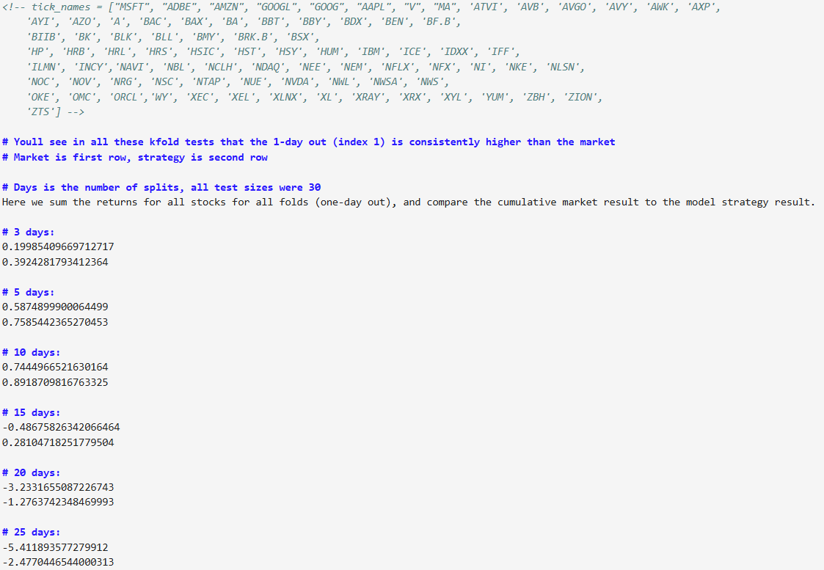
Our Model Shows Signs of Better Returns than the Market, One day out – Example

Slide 16
Our Model Consistently Outperforms in One-Day Returns On a Market Downturn
Cumulative % returns of all stocks
1 day, out, 3 days out, 5 days out, 10 days out, 15 days out
Market:
-2.3042723661297244,
-0.9333272942789951,
-0.14584513373308106,
0.35122795063400636,
-1.024532090313211
Model:
-1.4473174891483254,
-0.17377254442472712,
0.6722388493157005,
1.1551844255420516,
0.2184204356297733

Slide 17
Our Model Consistently Outperforms in One-Day Returns On a Market Downturn
100 randomized splits over the data.
See if the market cumulative return is less than 0.
Of the 49 market downturns, our model performed better 42 times.
Similar results on every repeat experiment.
Similar trend for time-series cross-validation

Slide 18
Time-Series Analysis

Slide 19
Facebook Prophet Library for Time-series Predictions
Classifying a stock with Prophet
Prophet is used in many applications across Facebook for producing reliable forecasts for planning and goal setting.
Factors in date irregularities such as holidays or global events.
Get a reasonable forecast on messy data with little manual effort.
Robust to outliers, missing data, and dramatic changes in time-series data.

Slide 20
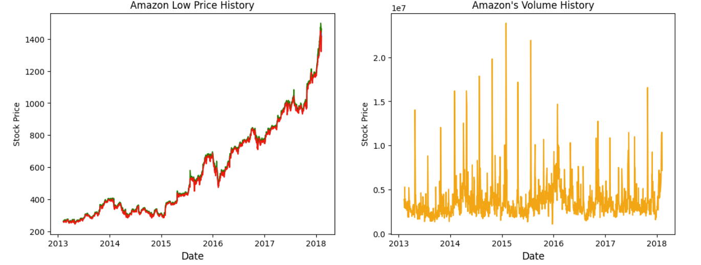
Prophet – AMZN Example
Stock History

Slide 21
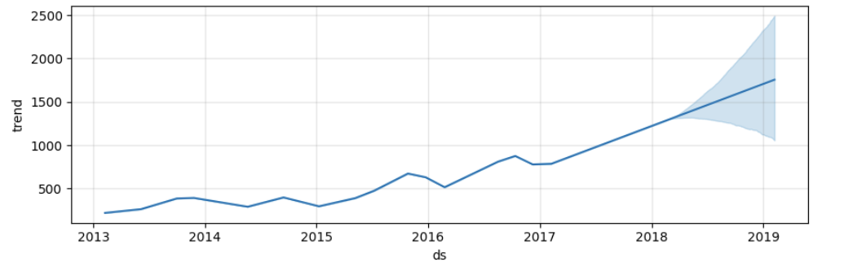
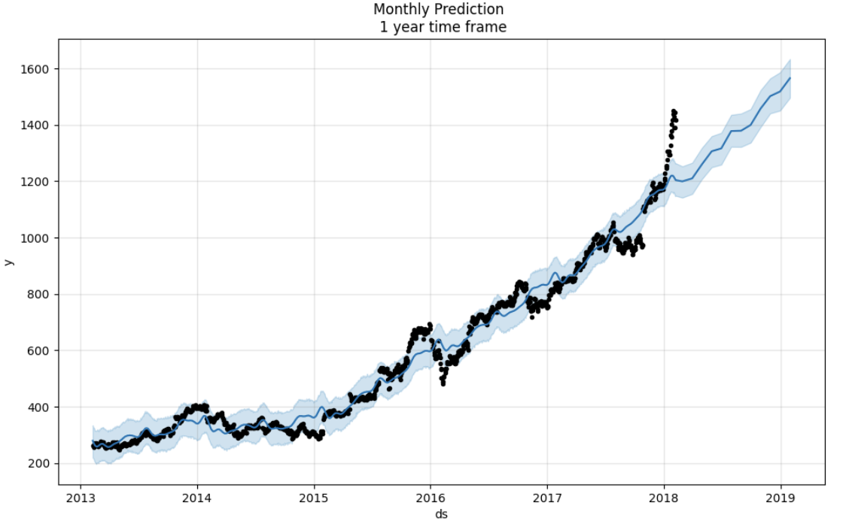
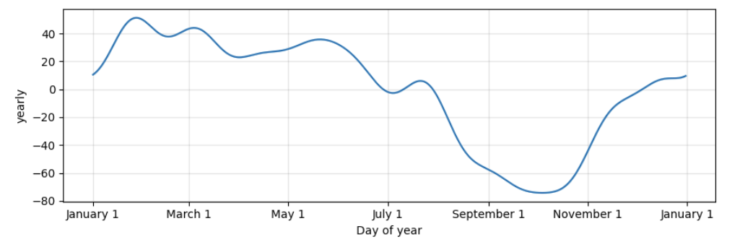
Prophet – AMZN Example
Predicting a stock with Prophet

Slide 22
Vector Auto regression
Traditional time series model for macro economic applications
Forecast future price using previous price and price of other stocks in the system
Simple implementation

Slide 23
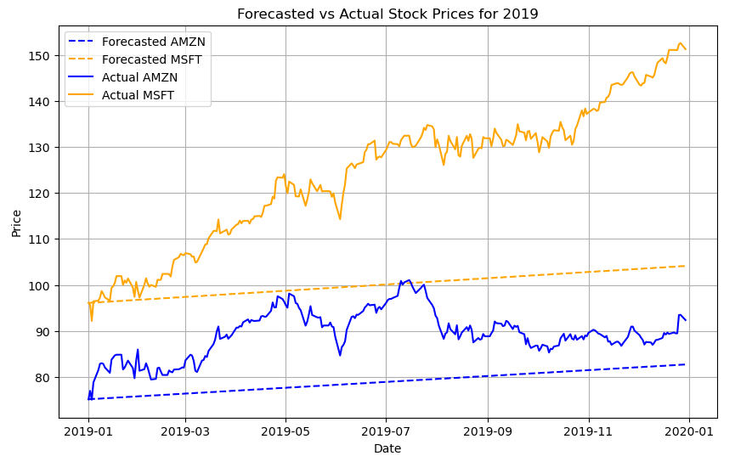
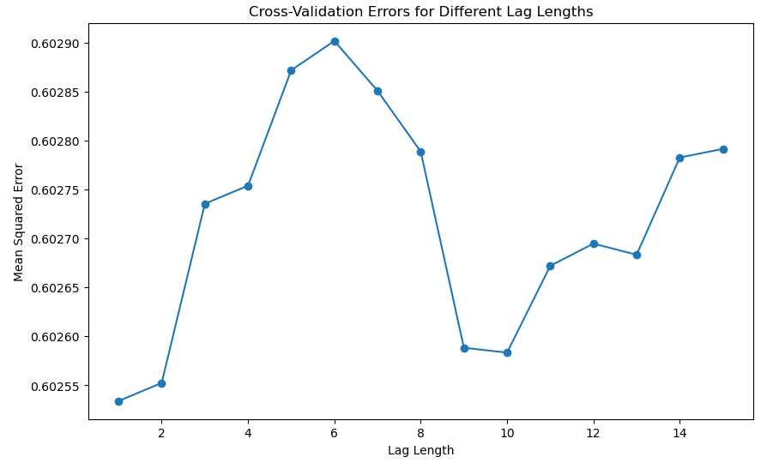
Vector Auto Regression Results

Slide 24
SVR Model

Slide 25
Svr trading strategy portfolio
Implemented SVR trading strategy on bucket of stocks from the dataset: FITB, GOOGL, IBM, MSI, CSCO, PPG, ULTA, KMB
Features: previous close price, 7 day moving average, 14 day moving average, volatility, and alpha value.
Used 7 day rolling average to predict 8th day as buy, sell, or hold
Generated trading signals as buy, hold, or sell using a threshold of 0.01
Simulated trades based on generated signals and calculated the portfolio value over time. Next, we compared the strategy to buying and holding the the same bucket of stocks over a time period.

Slide 26
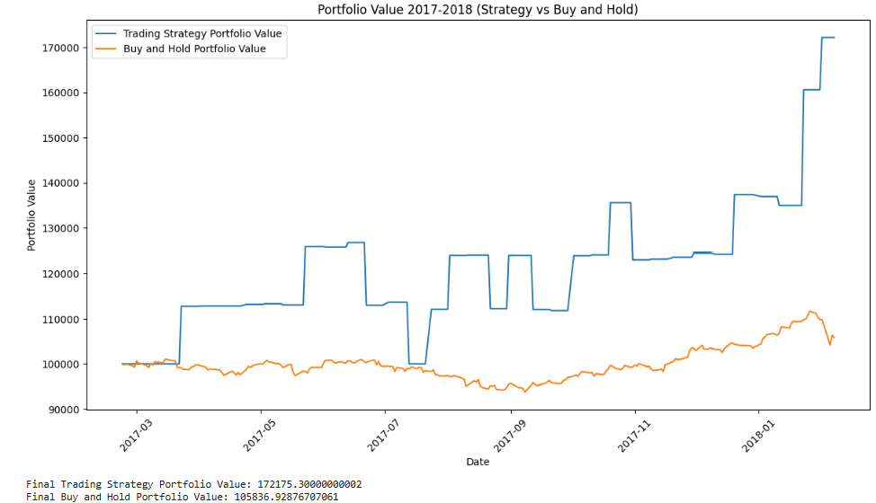
Svr trading strategy portfolio
*Trained on data for FITB, GOOGL, IBM, MSI, CSCO, PPG, ULTA, KMB from 2013-2016. Tested on 2017-2018

Slide 27
THANK YOU

